Slide 1
An Y2 A Level Lesson
Using the LDS to teach content on the Normal distribution, including Normal Approximation to Binomial and Hypothesis Testing
Notes:
Problem is that none of the data is normally distributed, which makes assumption of normality for hypothesis tests not possible. As the A level syllabus does not include the CLT, this is a bit of a problem. I have therefore concentrated on looking at how we can decide if data is normal or not, using calculation and graphical representation. I have then gone on to look at how a binomial distribution can be approximated by normal. I have introduced hypothesis testing by this route, although I’m not sure whether its really on the new syllabus.

Slide 2
The Normal Distribution
Testing to see if a set of data is normally distributed
Using a Normal distribution to approximate a Binomial Distribution
Hypothesis tests
Notes:
The material is probably enough for two lessons (maybe even 3!) I thought it was helpful to cover a range of different things they could dip into.

Slide 3
The Normal Distribution
I will be using the new AQA data set for teaching Year 12 from Sept 2018. This is about cars registered in 2002 and 2016
AQA data set

Slide 4
Is my data normally distributed?

Slide 5
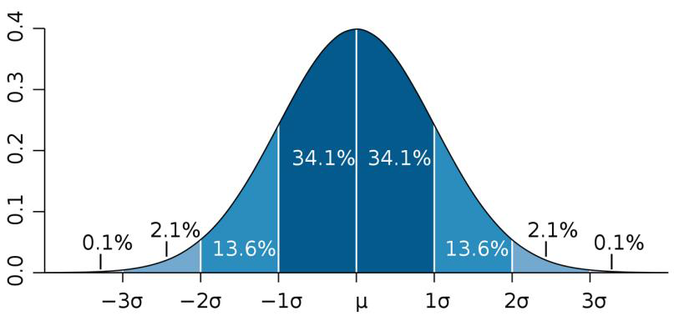
68% of the data lies within one standard deviation of the mean
95% of the data lies within two standard deviations of the mean
99.7% of the data lie within three standard deviations of the mean
In theory the curve extends infinitely in both directions, but the chance of finding data items outside the 3 standard deviation mark is very small.

Slide 6
Is my data normally distributed?
Analyse the data from the LDS
Extract 2002 diesel vehicles CO2 emissions
Copy the data into Autograph
Analyse with:
Box and Whisker
Histogram
Mean +/- 3 sd
Superimpose normal distribution with same mean and sd
Notes:
I will model this, as they follow along on their laptops, with one set of data, then show some others
The advantage of Autograph is we can easily see the mean +/- 3sd, and graphs can be hidden or shown for maximum effect.
Graphs I have on my autograph file are: CO2 levels for:
2002 Diesel for cars < 2000cc; 2002 VW Diesel; 2016 VW Diesel; 2016 all vehicles diesel; 2016 Diesel with outliers removed.

Slide 7
Using Geogebra
Open Geogebra Classic and spreadsheet view
Copy the same data into the first column of the spreadsheet
Analyse with graphs and the Normal quantile plot
Notes:
Note when copying and pasting into geogebra, use CTRL C to copy and CTRL V to paste. Large data sets take a little while to appear.
The advantage of geogebra is the outliers are clear to see and this can help, in conjunction with the quantile plot, to see where the issues lie.

Slide 8
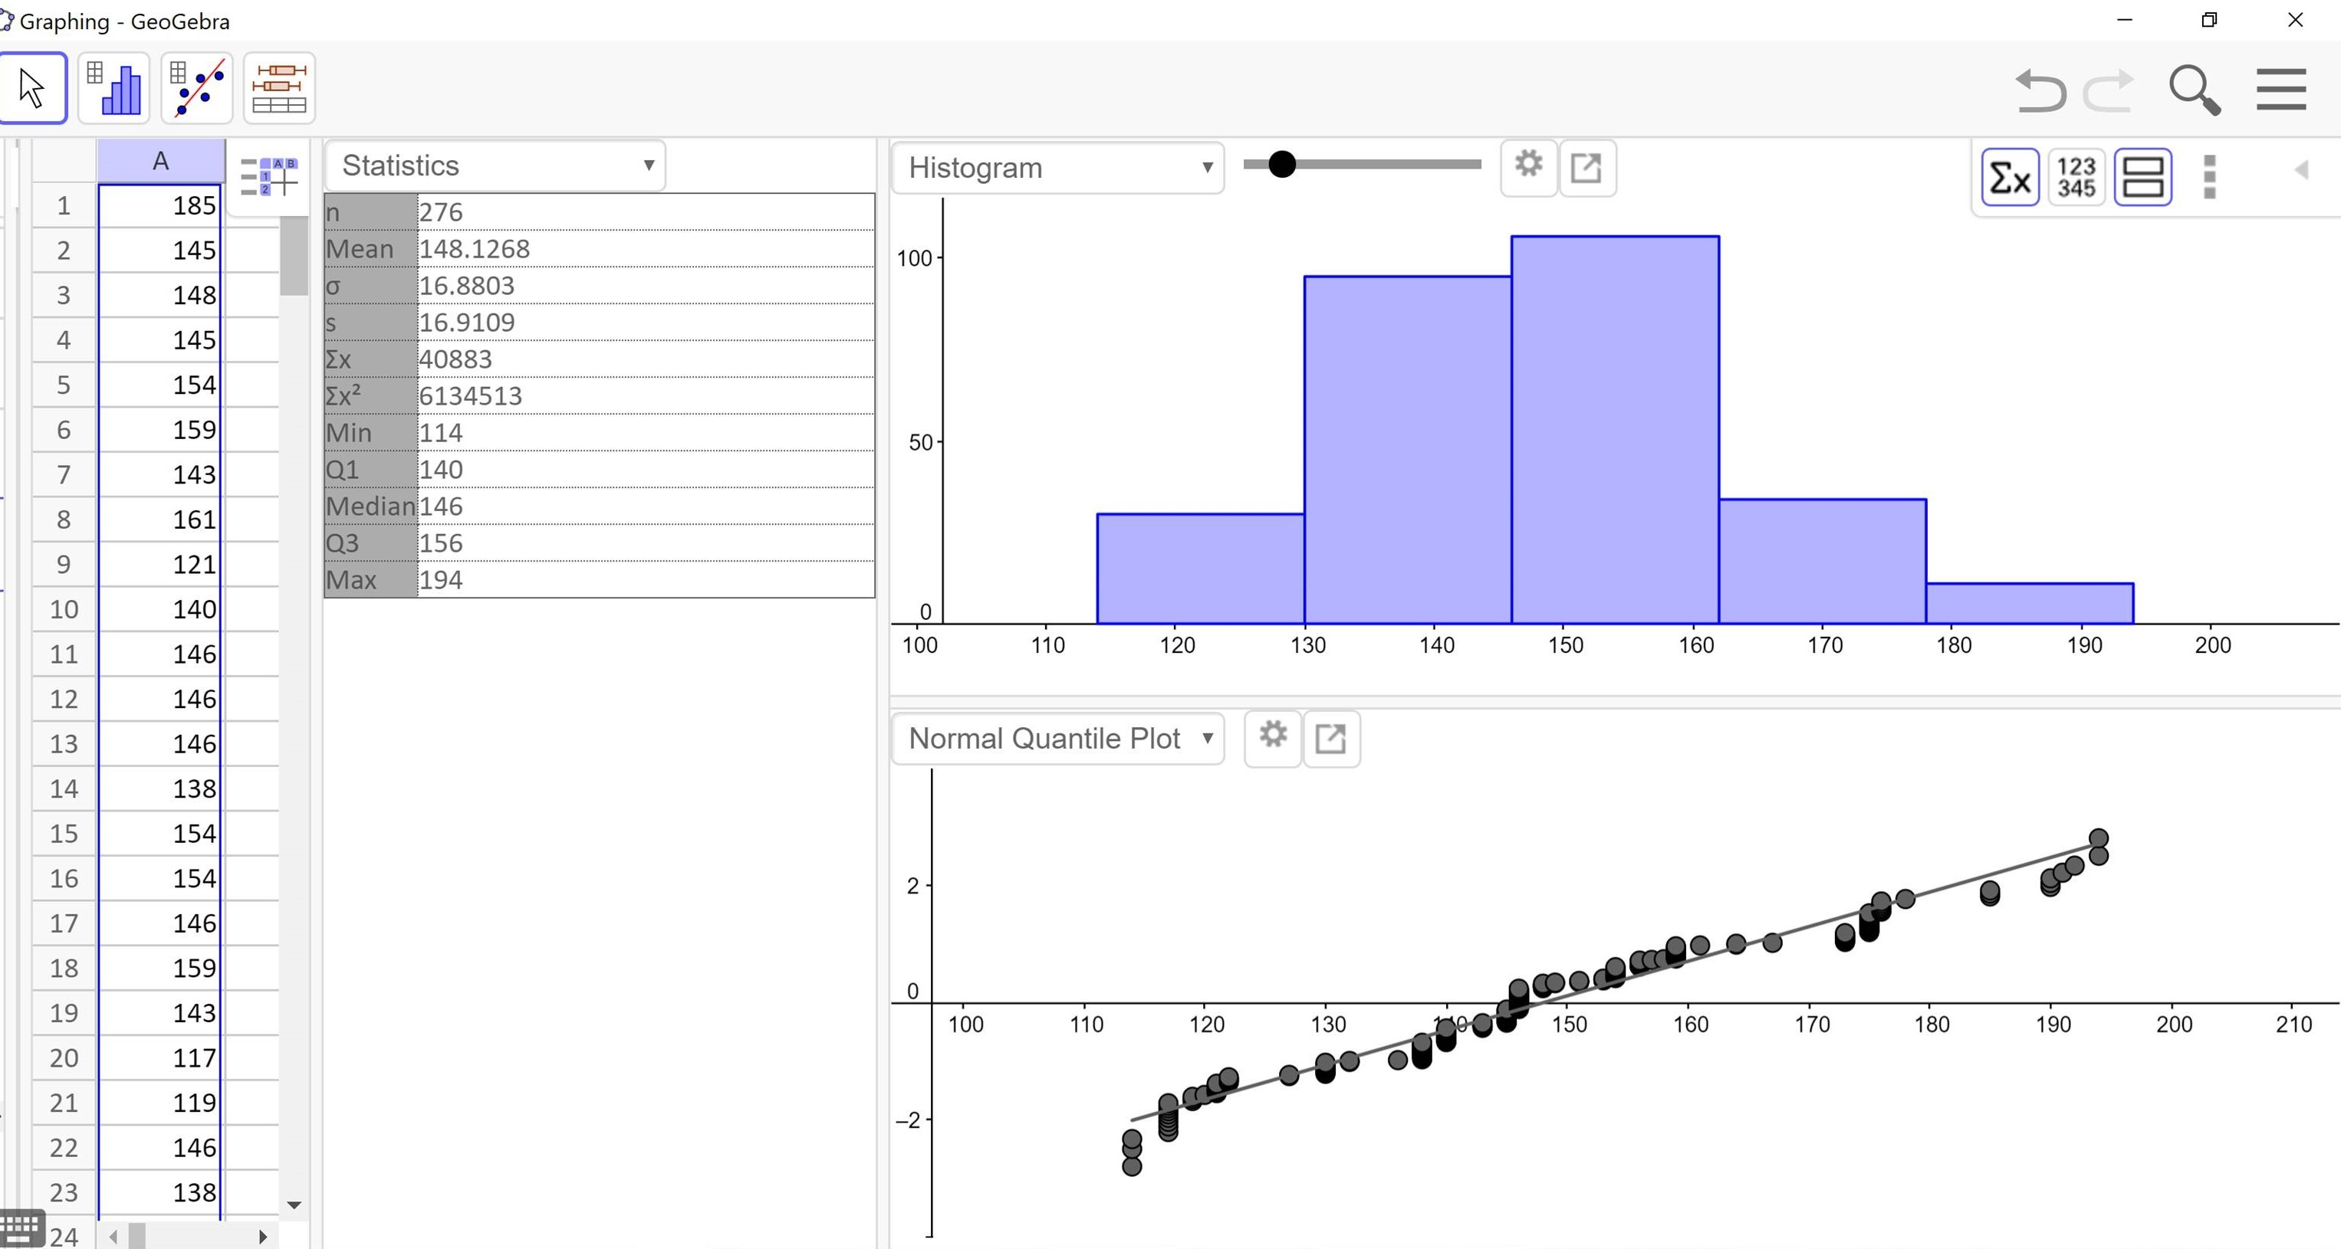
Notes:
Talk about features – note mean and median are not that similar, despite appearance of quantile plot

Slide 9
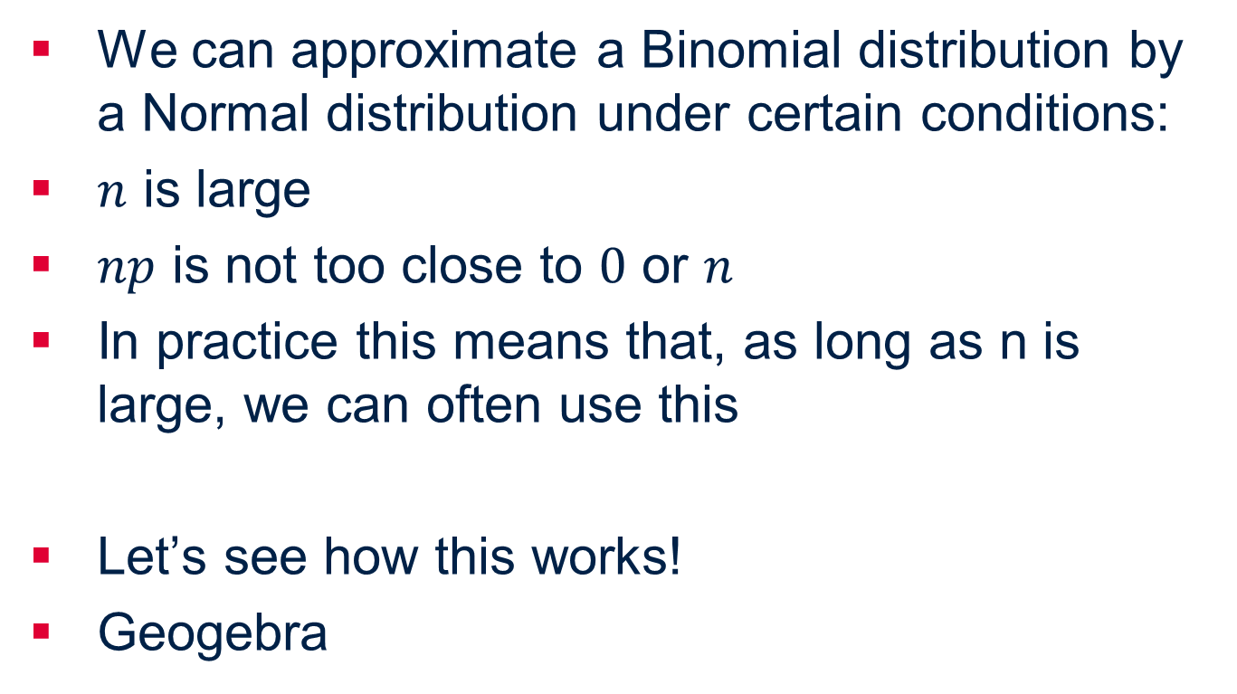
Normal approximation to Binomial
We can approximate a Binomial distribution by a Normal distribution under certain conditions:
$n$ is large
$np$ is not too close to $0$ or $n$
In practice this means that, as long as n is large, we can often use this
Let’s see how this works!
Geogebra
Notes:
Open geogebra and show how binomial approximates to Normal at different values of n and p

Slide 10
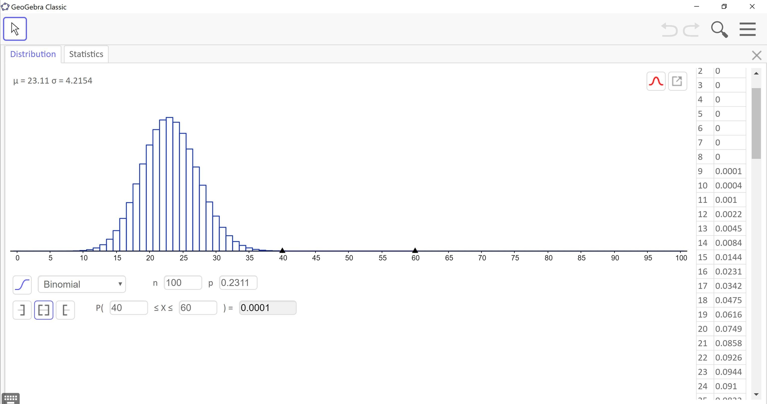

Slide 11
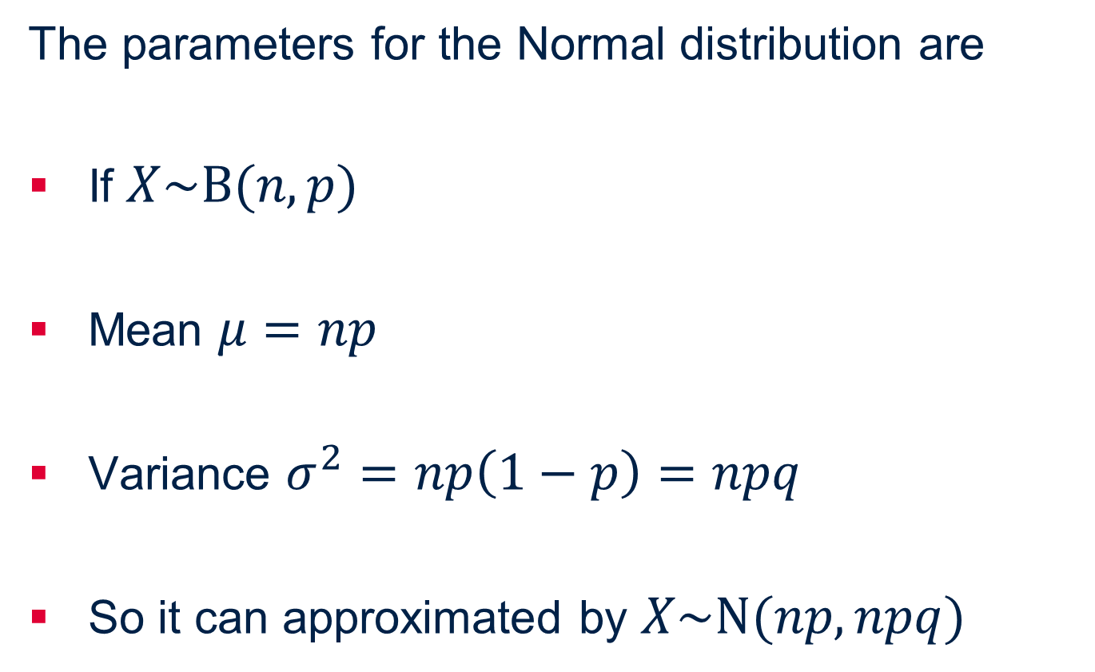
Normal approximation to Binomial
The parameters for the Normal distribution are
If $X\sim B(n,p)$
Mean $μ=np$
Variance $σ^{2}=np\left(1−p\right)=npq$
So it can approximated by $X\sim N(np,npq)$

Slide 12
Normal approximation to Binomial
Let’s see how this works!
In 2002, in the regions covered by the data set, 31% of the cars were Ford cars.
I believe that Ford cars would be less popular in 2016, so I took a sample of 120 from the 2016 data. In my sample, 33 were Ford cars.

Slide 13
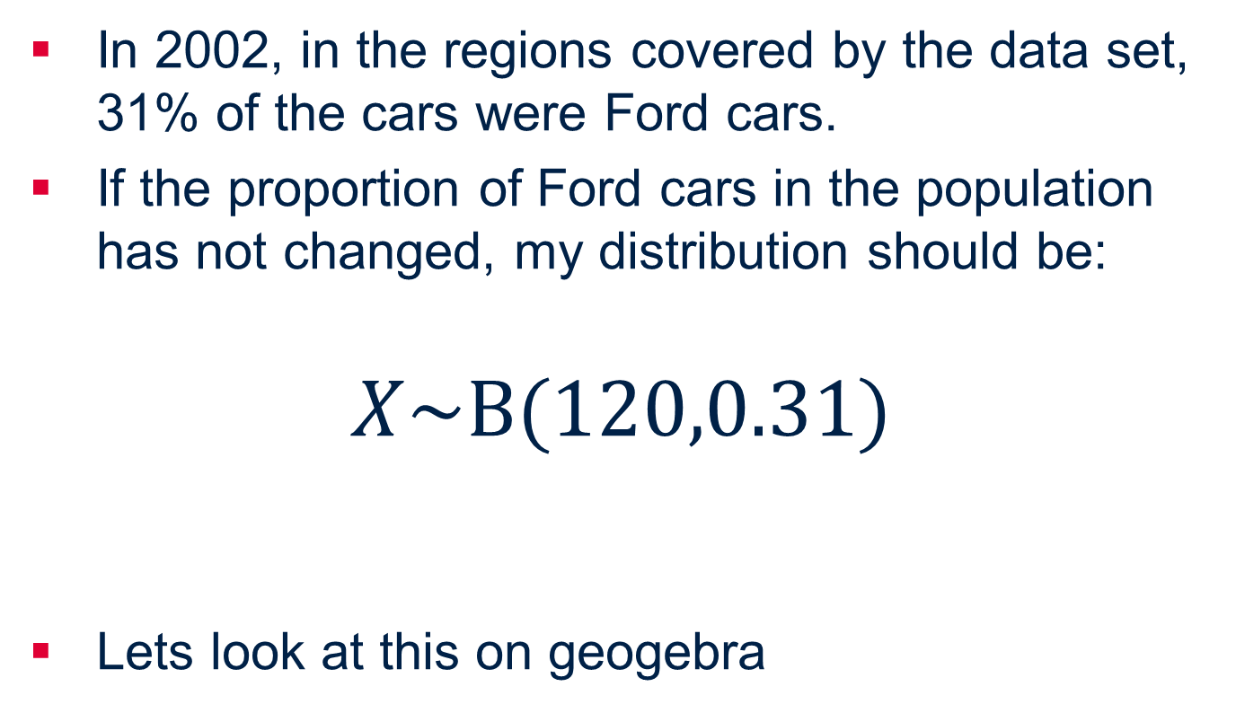
Normal approximation to Binomial
In 2002, in the regions covered by the data set, 31% of the cars were Ford cars.
If the proportion of Ford cars in the population has not changed, my distribution should be:
$$X\sim B(120,0.31)$$
Lets look at this on geogebra
Notes:
Open geogebra and put parameters in for X~B(120,0.31). Show it looks very normal

Slide 14
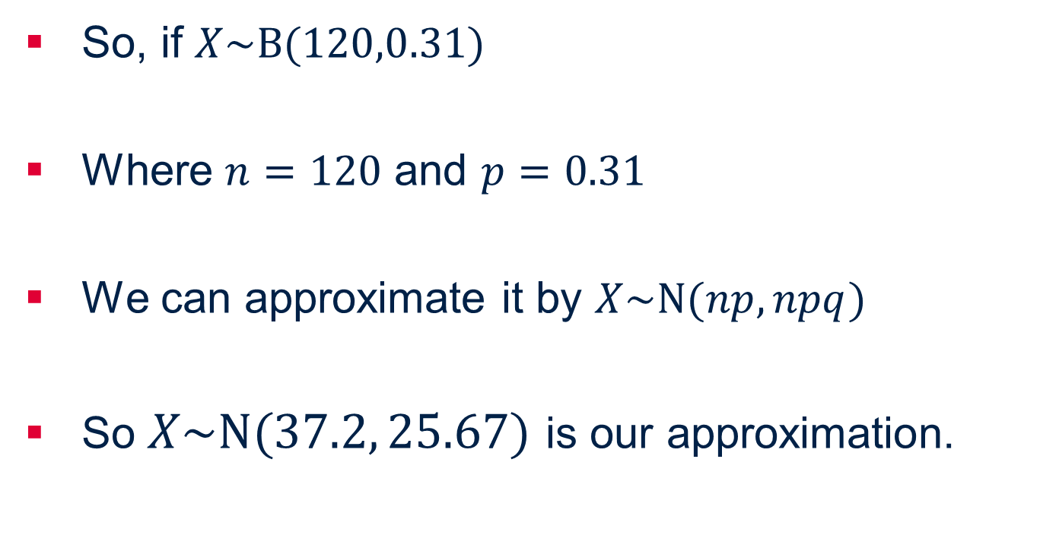
Normal approximation to Binomial
So, if $X\sim B(120,0.31)$
Where $n=120$ and $p=0.31$
We can approximate it by $X\sim N(np,npq)$
So $X\sim N(37.2, 25.67)$ is our approximation.

Slide 15
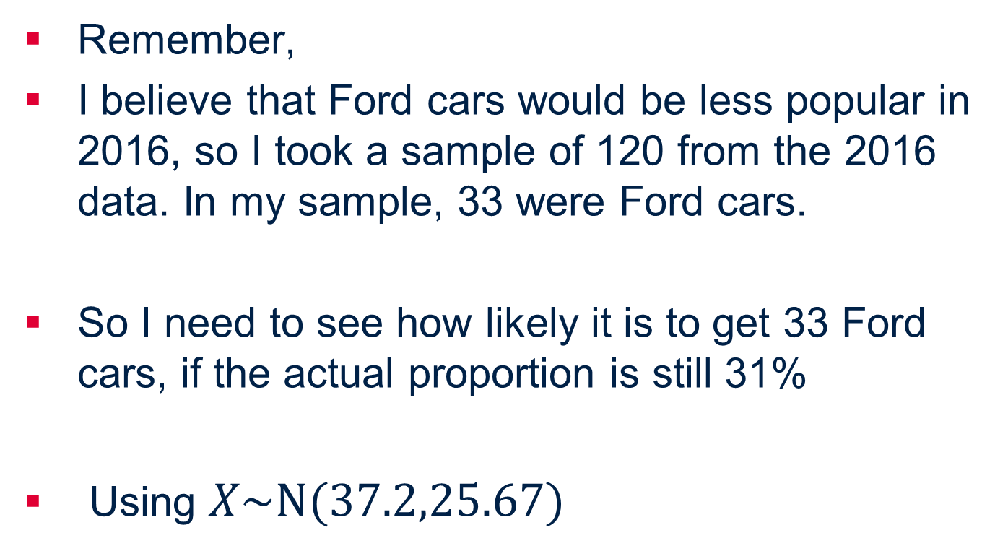
Normal approximation to Binomial
Remember,
I believe that Ford cars would be less popular in 2016, so I took a sample of 120 from the 2016 data. In my sample, 33 were Ford cars.
So I need to see how likely it is to get 33 Ford cars, if the actual proportion is still 31%
Using $X\sim N(37.2,25.67)$

Slide 16
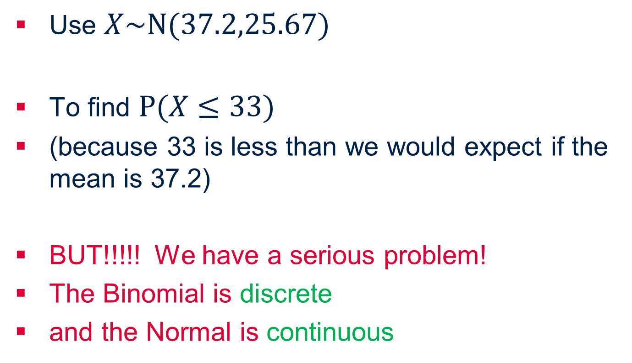
Normal approximation to Binomial
Use $X\sim N(37.2,25.67)$
To find $P(X≤33)$
(because 33 is less than we would expect if the mean is 37.2)
BUT!!!!! We have a serious problem!
The Binomial is discrete
and the Normal is continuous
Notes:
Explain about directional probability for Normal

Slide 17
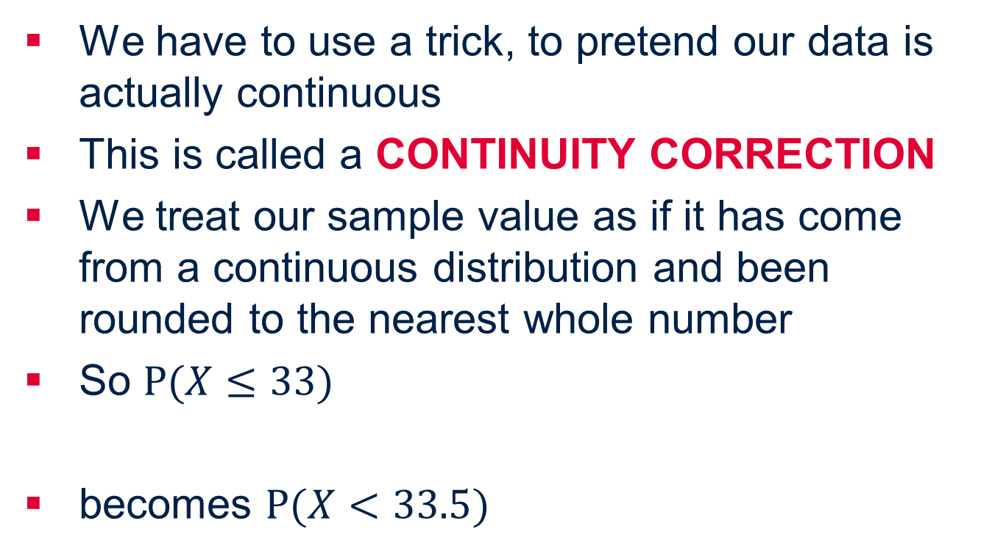
Normal approximation to Binomial
We have to use a trick, to pretend our data is actually continuous
This is called a CONTINUITY CORRECTION
We treat our sample value as if it has come from a continuous distribution and been rounded to the nearest whole number
So $P(X≤33)$
becomes $P(X<33.5)$
Notes:
Assume participants are familiar with how to find normal probabilities.

Slide 18
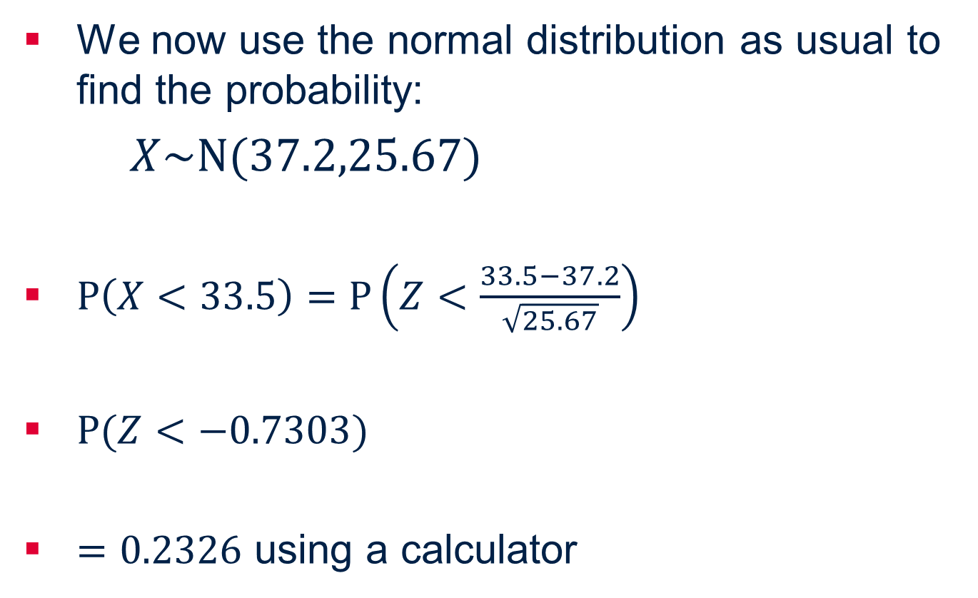
Normal approximation to Binomial
We now use the normal distribution as usual to find the probability:
$X\sim N(37.2,25.67)$
$P\left(X<33.5\right)=P\left(Z<\frac{33.5−37.2}{\sqrt{25.67}}\right)$
$P(Z<−0.7303)$
$=0.2326$ using a calculator
Notes:
This is quite a high probability, so maybe I’m wrong in my assumption.

Slide 19
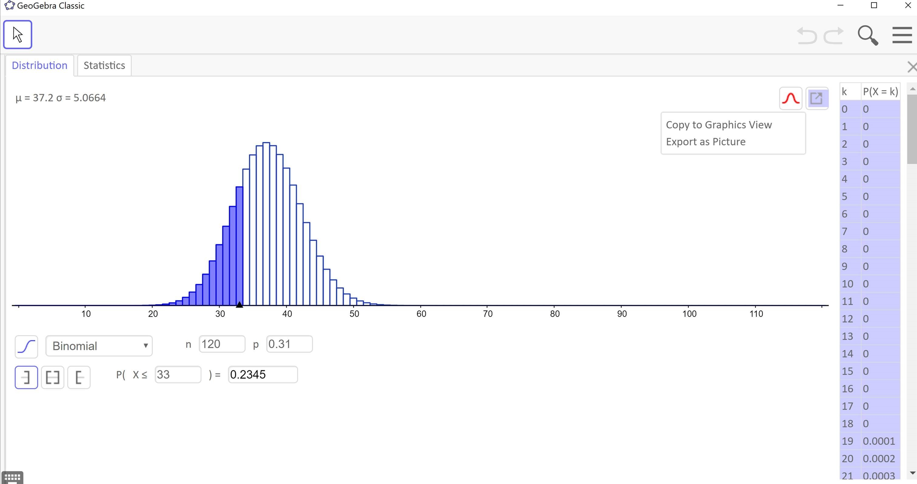
Notes:
Compare with the actual probability using Binomial – very close

Slide 20
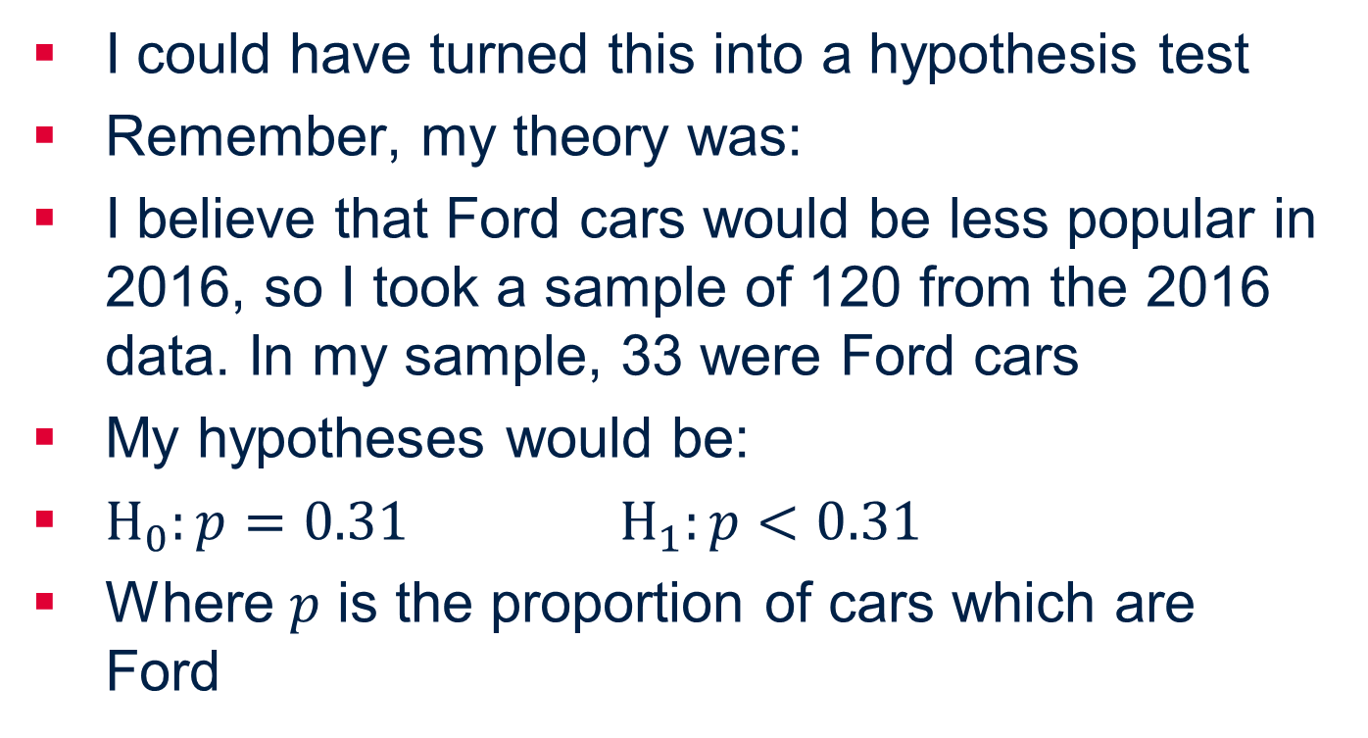
Hypothesis testing
I could have turned this into a hypothesis test
Remember, my theory was:
I believe that Ford cars would be less popular in 2016, so I took a sample of 120 from the 2016 data. In my sample, 33 were Ford cars
My hypotheses would be:
$H_{0}:p=0.31$ $H_{1}:p<0.31$
Where $p$ is the proportion of cars which are Ford
Notes:
Note it’s very important to define p.

Slide 21
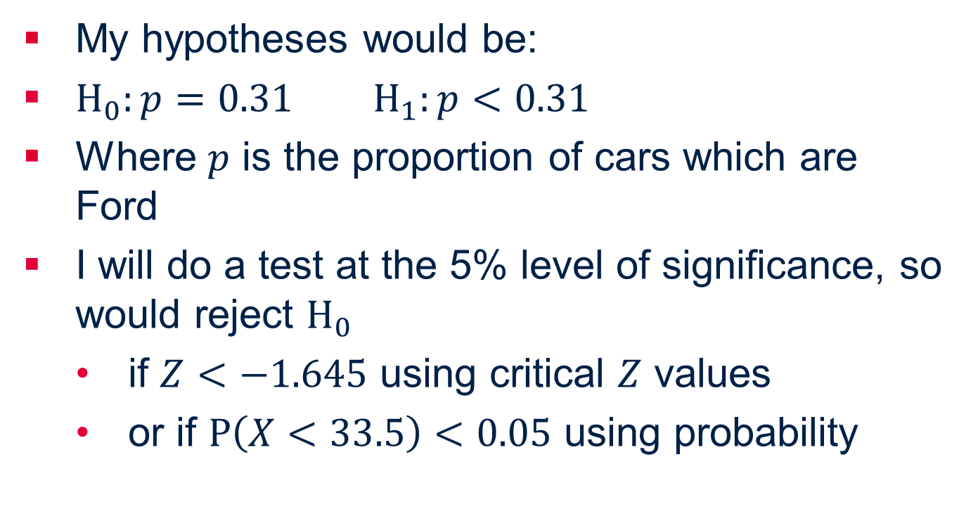
Hypothesis testing
My hypotheses would be:
$H_{0}:p=0.31$ $H_{1}:p<0.31$
Where $p$ is the proportion of cars which are Ford
I will do a test at the 5% level of significance, so would reject $H_{0}$
  if $Z<−1.645$ using critical $Z$ values
  or if $P\left(X<33.5\right)<0.05$ using probability

Slide 22
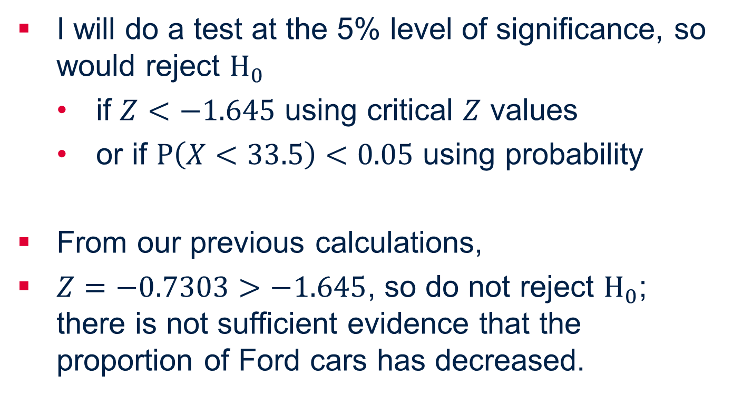
Hypothesis testing
I will do a test at the 5% level of significance, so would reject $H_{0}$
  if $Z<−1.645$ using critical $Z$ values
  or if $P\left(X<33.5\right)<0.05$ using probability
From our previous calculations,
$Z=−0.7303>−1.645$, so do not reject $H_{0}$; there is not sufficient evidence that the proportion of Ford cars has decreased.

Slide 23
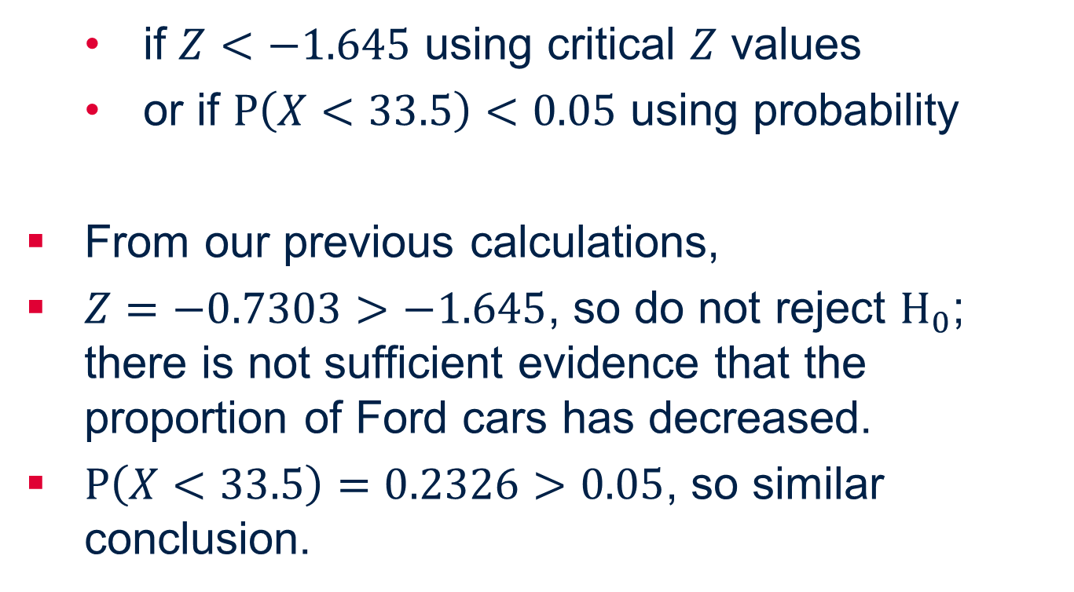
Hypothesis testing
  if $Z<−1.645$ using critical $Z$ values
  or if $P\left(X<33.5\right)<0.05$ using probability
From our previous calculations,
$Z=−0.7303>−1.645$, so do not reject $H_{0}$; there is not sufficient evidence that the proportion of Ford cars has decreased.
$P\left(X<33.5\right)=0.2326>0.05$, so similar conclusion.
Notes:
This gives the p value as 0.2326
NOTE: In fact, the proportion of Ford cars HAS decreased (from the full data set, its 0.27) so this could show up if different students took their own samples and did their own calculations. For Further Maths students, this leads well into Type I and Type II errors

Slide 24
Further Work
Take your own samples and compare results
Use your own data sets to fit to distributions or do hypothesis tests.

